Slide 1
Chapter 6 Differential Analysis of Flow
CE30460 - Fluid Mechanics
Diogo Bolster

Slide 2
Chapter Goals
Kinematics of given flow field
Continuous Continuity Equation
Navier-Stokes and Specific Solutions
Concepts of Potential Flow

Slide 3
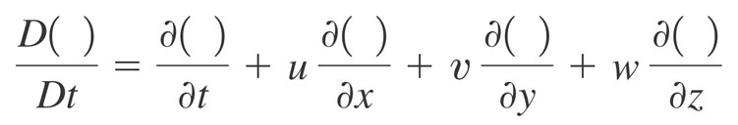
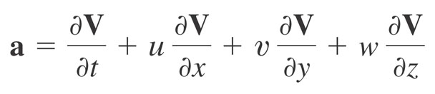
Kinematics
Recall Material Derivative (Lagrangian vs Eulerian)
Acceleration of a fluid element

Slide 4
Types of Motion
Translation
Linear Deformation
Rotation
Angular Deformation
Draw each of these for a rectangular initial element….

Slide 5
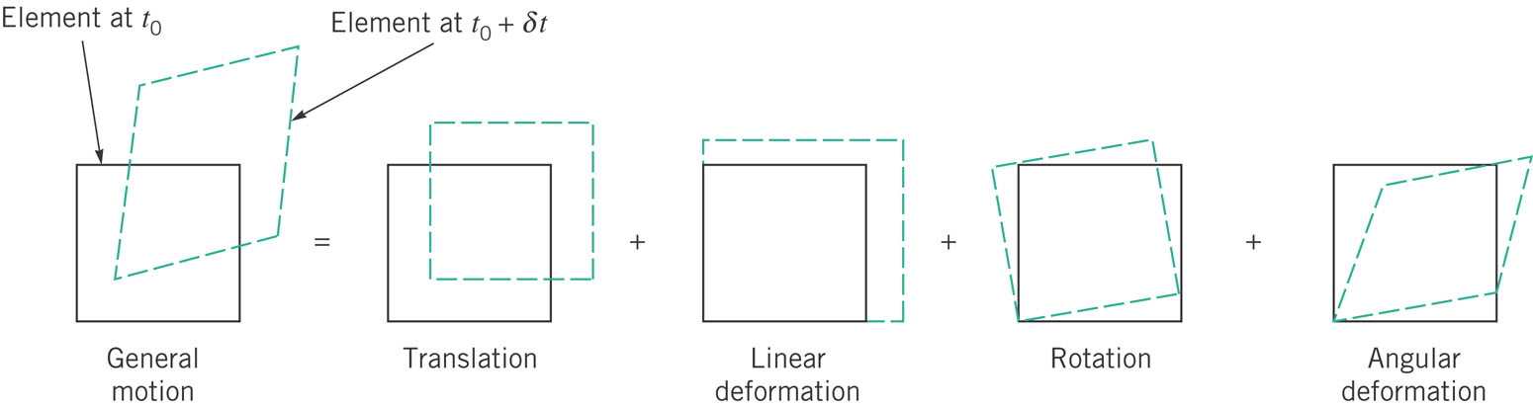
Types of Motion

Slide 6
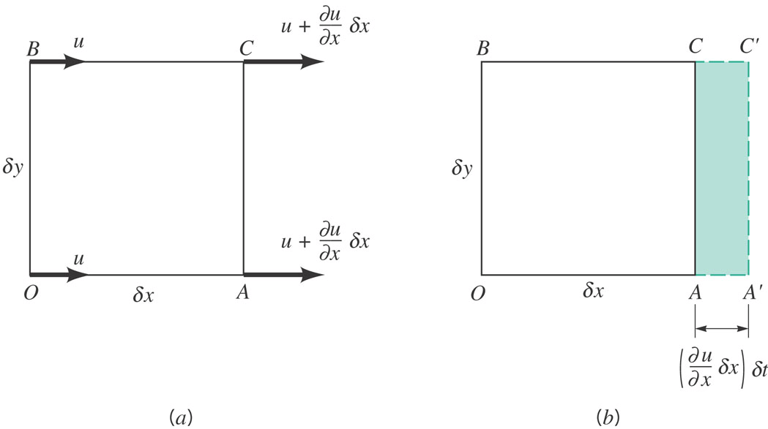
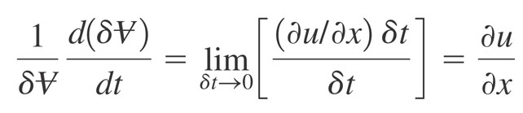
Linear Motion and Deformation

Slide 7
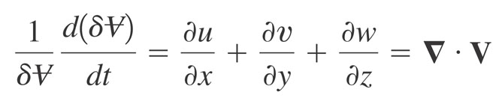
In 3 dimensions
Volumetric Dilatation Rate

Slide 8
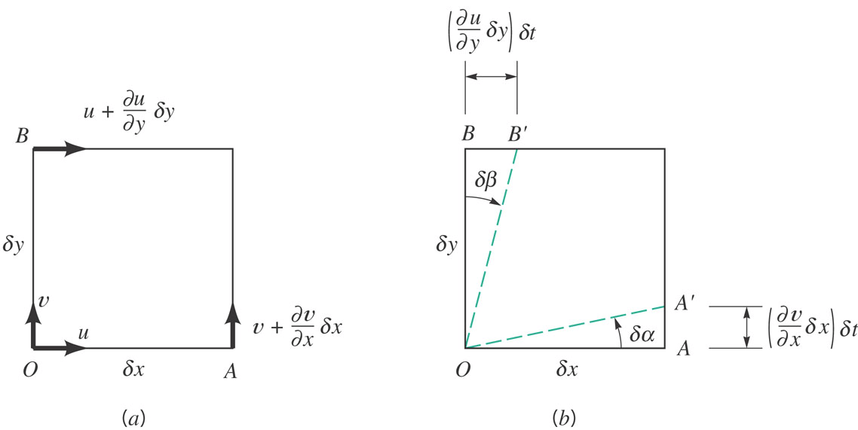
Angular Motion and Deformation

Slide 9
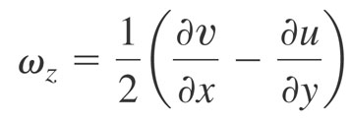

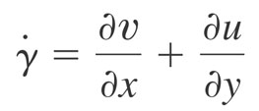
Vorticity (Rotation)
Counterclockwise rotation is positive (z component is component out of the page). Others, in x-y also exist
vorticity (zero => irrotational)
Related, rate of shearing strain

Slide 10
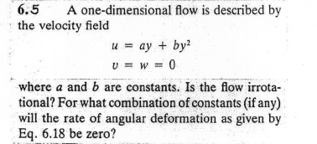
Sample Problem 1

Slide 11
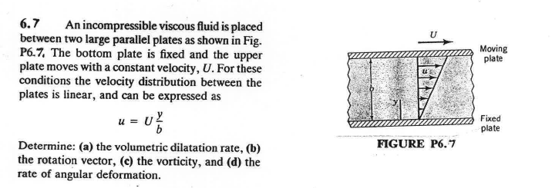
Sample Problem 2

Slide 12
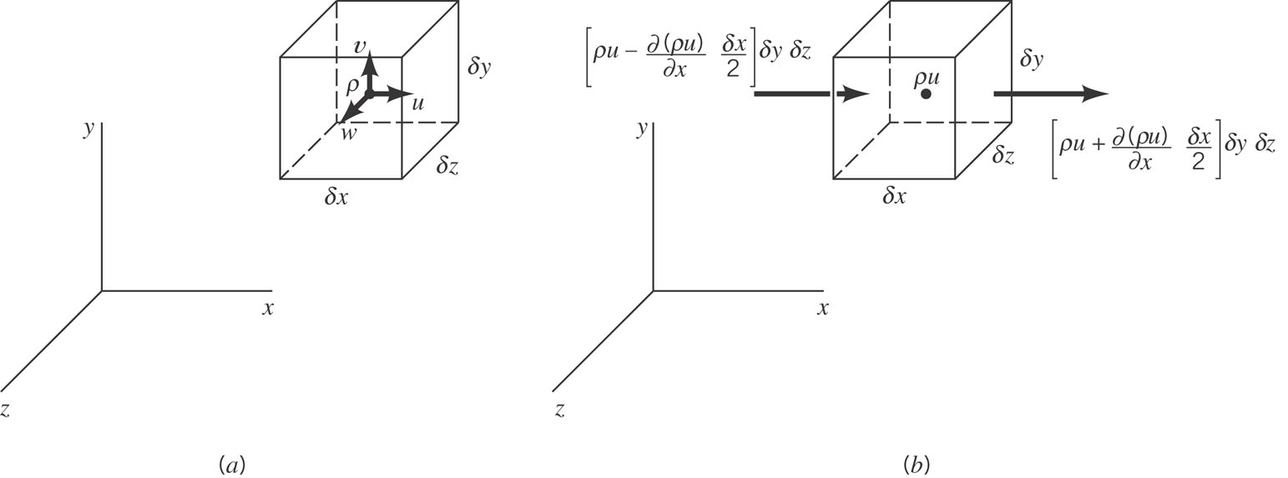
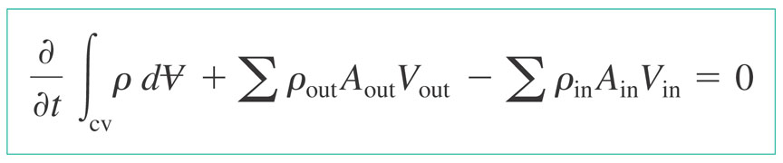
Conservation of Mass
But now in the limit of zero volume (to obtain differential form)

Slide 13
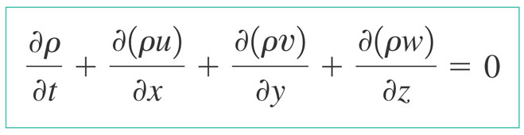
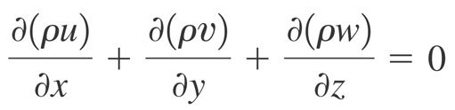
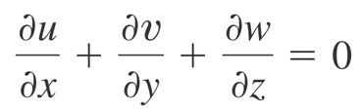

Forms of Continuity Equation
General Form
Steady
Incompressible

Slide 14
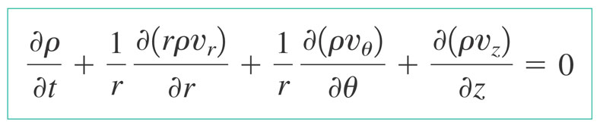
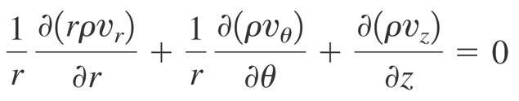
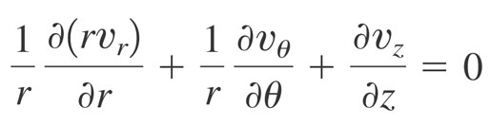
Cylindrical Polar Coordinates
General Form
Steady
Incompressible

Slide 15
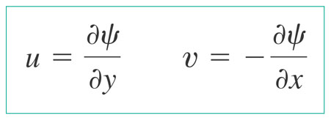
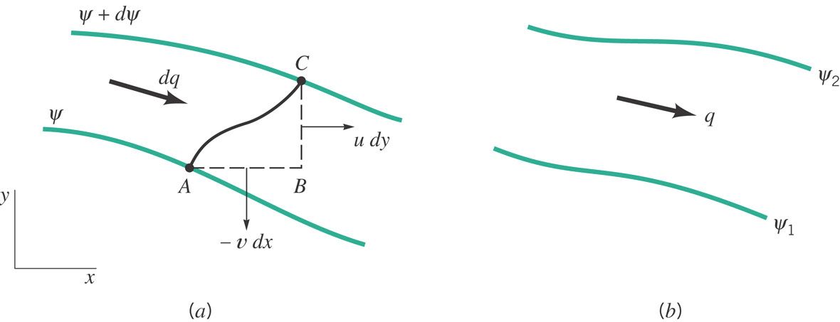
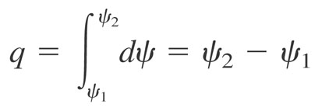
Streamfunction
For incompressible, plane two dimensional flow we can define a streamfunction psi, such that
Quantifies the flow rate between two streamlines (lines of constant psi)

Slide 16
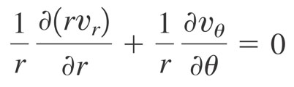
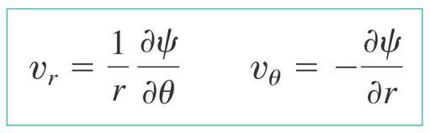
In cylindrical polar coordinates

Slide 17
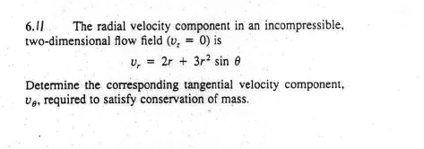
Sample Problem 1

Slide 18
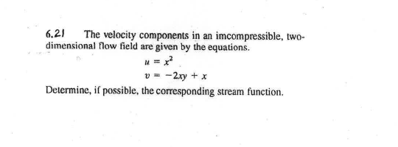
Sample Problem 2

